Slide 1
The Life of Christ
Review Of The Course

Slide 2
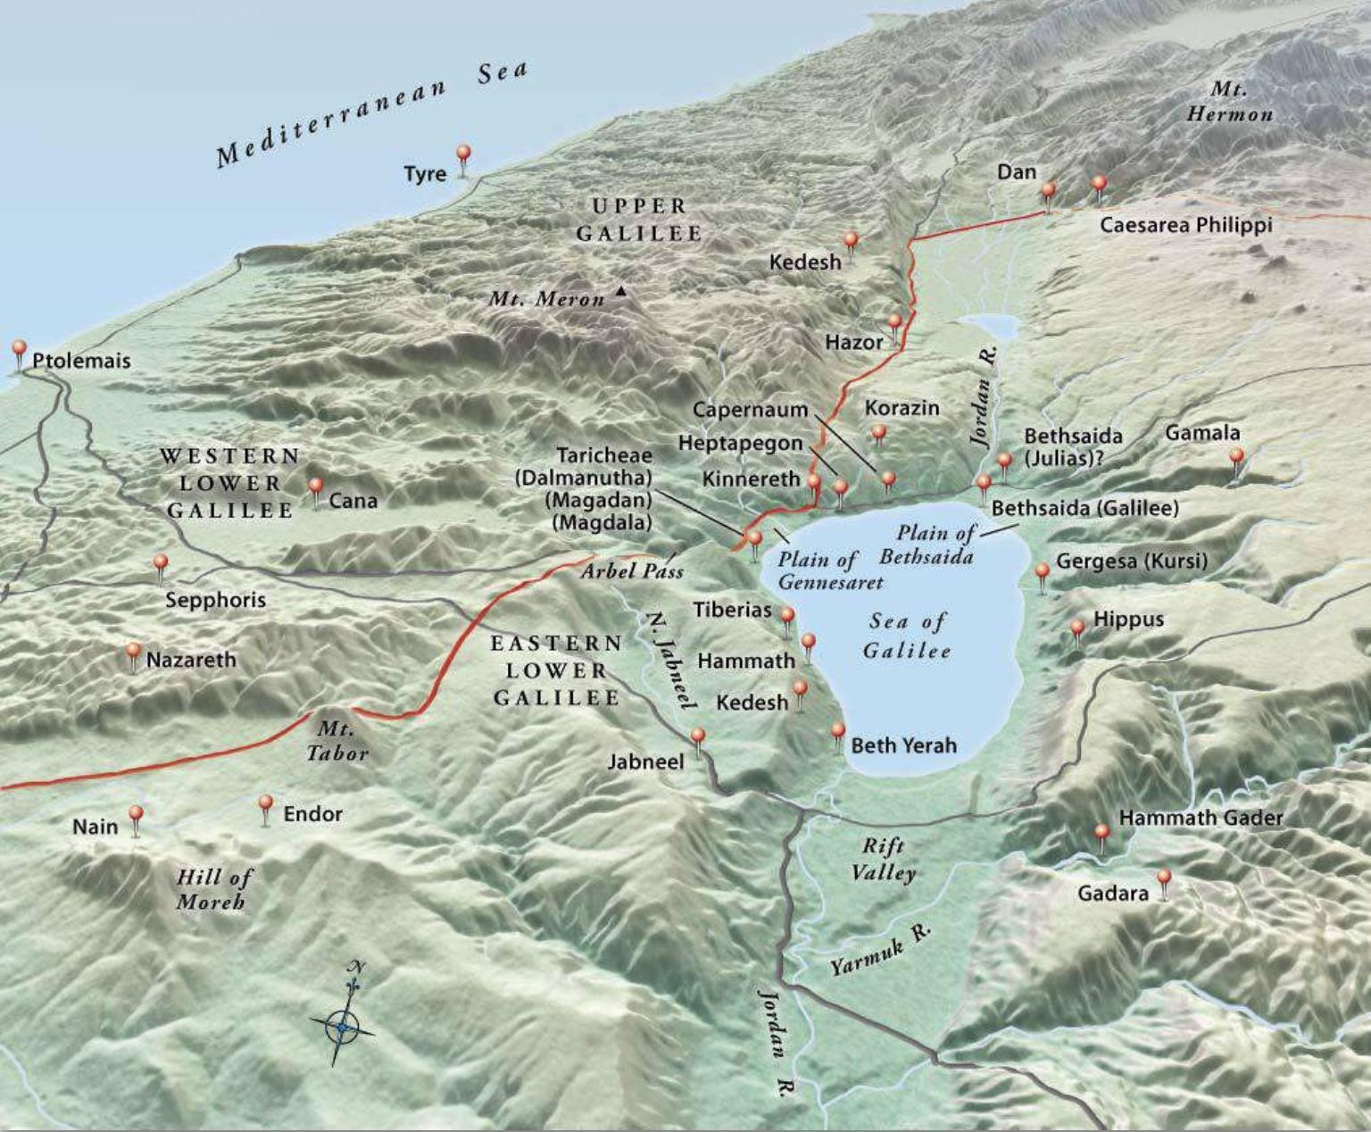
Topographical Map of Galilee (https://biblestudy.tips/bible-maps/)

Slide 3
Review: In Galilee and Beyond
Discourse on Spiritual Food and True Discipleship
(John 6:22-71)
An Exchange Over Tradition, Ceremony, and Defilement (Matthew 15:1-20; Mark 7:1-23; John 7:1)
Healing a Phoenician Woman’s Daughter (Matthew 15:21-28; Mark 7:24-30)
The Feeding of the Four Thousand (Matthew 15:29-38;
Mark 7:31-8:9)
The Pharisaic Leaven (Matthew 15:39-16:12; Mark 8:10-26)
The Confession of Peter (Matthew 16:13-20; Mark 8:27-30; Luke 9:18-21)
Notes:
John 6:22-71 – “22 On the next day the crowd that remained on the other side of the sea saw that there had been only one boat there, and that Jesus had not entered the boat with his disciples, but that his disciples had gone away alone. 23 Other boats from Tiberias came near the place where they had eaten the bread after the Lord had given thanks. 24 So when the crowd saw that Jesus was not there, nor his disciples, they themselves got into the boats and went to Capernaum, seeking Jesus. 25 When they found him on the other side of the sea, they said to him, ‘Rabbi, when did you come here?’ 26 Jesus answered them, ‘Truly, truly, I say to you, you are seeking me, not because you saw signs, but because you ate your fill of the loaves. 27 Do not labor for the food that perishes, but for the food that endures to eternal life, which the Son of Man will give to you. For on him God the Father has set his seal.’ 28 Then they said to him, ‘What must we do, to be doing the works of God?’ 29 Jesus answered them, ‘This is the work of God, that you believe in him whom he has sent.’ 30 So they said to him, ‘Then what sign do you do, that we may see and believe you? What work do you perform? 31 Our fathers ate the manna in the wilderness; as it is written, “He gave them bread from heaven to eat.”' 32 Jesus then said to them, ‘Truly, truly, I say to you, it was not Moses who gave you the bread from heaven, but my Father gives you the true bread from heaven. 33 For the bread of God is he who comes down from heaven and gives life to the world.’ 34 They said to him, ‘Sir, give us this bread always.’ 35 Jesus said to them, ‘I am the bread of life; whoever comes to me shall not hunger, and whoever believes in me shall never thirst. 36 But I said to you that you have seen me and yet do not believe. 37 All that the Father gives me will come to me, and whoever comes to me I will never cast out. 38 For I have come down from heaven, not to do my own will but the will of him who sent me. 39 And this is the will of him who sent me, that I should lose nothing of all that he has given me, but raise it up on the last day. 40 For this is the will of my Father, that everyone who looks on the Son and believes in him should have eternal life, and I will raise him up on the last day.’ 41 So the Jews grumbled about him, because he said, ‘I am the bread that came down from heaven.’ 42 They said, ‘"Is not this Jesus, the son of Joseph, whose father and mother we know? How does he now say, “I have come down from heaven”?’ 43 Jesus answered them, ‘Do not grumble among yourselves. 44 No one can come to me unless the Father who sent me draws him. And I will raise him up on the last day. 45 It is written in the Prophets, “And they will all be taught by God.” Everyone who has heard and learned from the Father comes to me – 46 not that anyone has seen the Father except he who is from God; he has seen the Father. 47 Truly, truly, I say to you, whoever believes has eternal life. 48 I am the bread of life. 49 Your fathers ate the manna in the wilderness, and they died. 50 This is the bread that comes down from heaven, so that one may eat of it and not die. 51 I am the living bread that came down from heaven. If anyone eats of this bread, he will live forever. And the bread that I will give for the life of the world is my flesh.’ 52 The Jews then disputed among themselves, saying, ‘How can this man give us his flesh to eat?’ 53 So Jesus said to them, ‘Truly, truly, I say to you, unless you eat the flesh of the Son of Man and drink his blood, you have no life in you. 54 Whoever feeds on my flesh and drinks my blood has eternal life, and I will raise him up on the last day. 55 For my flesh is true food, and my blood is true drink. 56 Whoever feeds on my flesh and drinks my blood abides in me, and I in him. 57 As the living Father sent me, and I live because of the Father, so whoever feeds on me, he also will live because of me. 58 This is the bread that came down from heaven, not as the fathers ate and died. Whoever feeds on this bread will live forever.’ 59 Jesus said these things in the synagogue, as he taught at Capernaum. 60 When many of his disciples heard it, they said, ‘This is a hard saying; who can listen to it?’ 61 But Jesus, knowing in himself that his disciples were grumbling about this, said to them, ‘Do you take offense at this? 62 Then what if you were to see the Son of Man ascending to where he was before? 63 It is the Spirit who gives life; the flesh is of no avail. The words that I have spoken to you are spirit and life. 64 But there are some of you who do not believe.’ (For Jesus knew from the beginning who those were who did not believe, and who it was who would betray him.) 65 And he said, ‘This is why I told you that no one can come to me unless it is granted him by the Father.’ 66 After this many of his disciples turned back and no longer walked with him.67 So Jesus said to the Twelve, ‘Do you want to go away as well?’ 68 Simon Peter answered him, ‘Lord, to whom shall we go? You have the words of eternal life, 69 and we have believed, and have come to know, that you are the Holy One of God.’ 70 Jesus answered them, ‘Did I not choose you, the Twelve? And yet one of you is a devil.’ 71 He spoke of Judas the son of Simon Iscariot, for he, one of the Twelve, was going to betray him.”
Matthew 15:1-20 – “1 Then Pharisees and scribes came to Jesus from Jerusalem and said, 2 ‘Why do your disciples break the tradition of the elders? For they do not wash their hands when they eat.’ 3 He answered them, ‘And why do you break the commandment of God for the sake of your tradition? 4 For God commanded,’ “Honor your father and your mother,” and, “Whoever reviles father or mother must surely die.” 5 ‘But you say, “If anyone tells his father or his mother, What you would have gained from me is given to God, 6 he need not honor his father.” ‘So for the sake of your tradition you have made void the word of God. 7 You hypocrites! Well did Isaiah prophesy of you, when he said: 8 “This people honors me with their lips, but their heart is far from me; 9 in vain do they worship me, teaching as doctrines the commandments of men." 10 And he called the people to him and said to them, ‘Hear and understand: 11 it is not what goes into the mouth that defiles a person, but what comes out of the mouth; this defiles a person.’ 12 Then the disciples came and said to him, ‘Do you know that the Pharisees were offended when they heard this saying?’ 13 He answered, ‘Every plant that my heavenly Father has not planted will be rooted up. 14 Let them alone; they are blind guides. And if the blind lead the blind, both will fall into a pit.’ 15 But Peter said to him, ‘Explain the parable to us.’ 16 And he said, ‘Are you also still without understanding? 17 Do you not see that whatever goes into the mouth passes into the stomach and is expelled? 18 But what comes out of the mouth proceeds from the heart, and this defiles a person. 19 For out of the heart come evil thoughts, murder, adultery, sexual immorality, theft, false witness, slander. 20 These are what defile a person. But to eat with unwashed hands does not defile anyone.’”
Mark 7:1-23 – “7 Now when the Pharisees gathered to him, with some of the scribes who had come from Jerusalem, 2 they saw that some of his disciples ate with hands that were defiled, that is, unwashed. 3 (For the Pharisees and all the Jews do not eat unless they wash their hands, holding to the tradition of the elders, 4 and when they come from the marketplace, they do not eat unless they wash. And there are many other traditions that they observe, such as the washing of cups and pots and copper vessels and dining couches. ) 5 And the Pharisees and the scribes asked him, ‘Why do your disciples not walk according to the tradition of the elders, but eat with defiled hands?’ 6 And he said to them, ‘Well did Isaiah prophesy of you hypocrites, as it is written, "This people honors me with their lips, but their heart is far from me; 7 in vain do they worship me, teaching as doctrines the commandments of men.” 8 You leave the commandment of God and hold to the tradition of men.’ 9 And he said to them, ‘You have a fine way of rejecting the commandment of God in order to establish your tradition! 10 For Moses said, “Honor your father and your mother”; and, “Whoever reviles father or mother must surely die.” 11 But you say, “If a man tells his father or his mother, Whatever you would have gained from me is Corban” (that is, given to God) – 12 then you no longer permit him to do anything for his father or mother, 13 thus making void the word of God by your tradition that you have handed down. And many such things you do.’ 14 And he called the people to him again and said to them, ‘Hear me, all of you, and understand: 15 There is nothing outside a person that by going into him can defile him, but the things that come out of a person are what defile him.’ 17 And when he had entered the house and left the people, his disciples asked him about the parable. 18 And he said to them, ‘Then are you also without understanding? Do you not see that whatever goes into a person from outside cannot defile him, 19 since it enters not his heart but his stomach, and is expelled?’ ( Thus he declared all foods clean.) 20 And he said, ‘What comes out of a person is what defiles him. 21 For from within, out of the heart of man, come evil thoughts, sexual immorality, theft, murder, adultery, 22 coveting, wickedness, deceit, sensuality, envy, slander, pride, foolishness. 23 All these evil things come from within, and they defile a person.’”
John 7:1 – “After this Jesus went about in Galilee. He would not go about in Judea, because the Jews were seeking to kill him.”
Matthew 15:21-28 – “21 And Jesus went away from there and withdrew to the district of Tyre and Sidon. 22 And behold, a Canaanite woman from that region came out and was crying, ‘Have mercy on me, O Lord, Son of David; my daughter is severely oppressed by a demon.’ 23 But he did not answer her a word. And his disciples came and begged him, saying, ‘Send her away, for she is crying out after us.’ 24 He answered, ‘I was sent only to the lost sheep of the house of Israel.’ 25 But she came and knelt before him, saying, ‘Lord, help me.’ 26 And he answered, ‘It is not right to take the children's bread and throw it to the dogs.’ 27 She said, ‘Yes, Lord, yet even the dogs eat the crumbs that fall from their masters' table.’ 28 Then Jesus answered her, ‘O woman, great is your faith! Be it done for you as you desire.’ And her daughter was healed instantly.”
Mark 7:24-30 – “24 And from there he arose and went away to the region of Tyre and Sidon. And he entered a house and did not want anyone to know, yet he could not be hidden. 25 But immediately a woman whose little daughter was possessed by an unclean spirit heard of him and came and fell down at his feet. 26 Now the woman was a Gentile, a Syrophoenician by birth. And she begged him to cast the demon out of her daughter. 27 And he said to her, ‘Let the children be fed first, for it is not right to take the children's bread and throw it to the dogs.’ 28 But she answered him, ‘Yes, Lord; yet even the dogs under the table eat the children's crumbs.’ 29 And he said to her, ‘For this statement you may go your way; the demon has left your daughter.’ 30 And she went home and found the child lying in bed and the demon gone.”
Matthew 15:29-38 – “29 Jesus went on from there and walked beside the Sea of Galilee. And he went up on the mountain and sat down there. 30 And great crowds came to him, bringing with them the lame, the blind, the crippled, the mute, and many others, and they put them at his feet, and he healed them, 31 so that the crowd wondered, when they saw the mute speaking, the crippled healthy, the lame walking, and the blind seeing. And they glorified the God of Israel. 32 Then Jesus called his disciples to him and said, ‘I have compassion on the crowd because they have been with me now three days and have nothing to eat. And I am unwilling to send them away hungry, lest they faint on the way.’ 33 And the disciples said to him, ‘Where are we to get enough bread in such a desolate place to feed so great a crowd?’ 34 And Jesus said to them, ‘How many loaves do you have?’ They said, ‘Seven, and a few small fish.’ 35 And directing the crowd to sit down on the ground, 36 he took the seven loaves and the fish, and having given thanks he broke them and gave them to the disciples, and the disciples gave them to the crowds. 37 And they all ate and were satisfied. And they took up seven baskets full of the broken pieces left over. 38 Those who ate were four thousand men, besides women and children.”
Mark 7:31-8:9 – “31 Then he returned from the region of Tyre and went through Sidon to the Sea of Galilee, in the region of the Decapolis. 32 And they brought to him a man who was deaf and had a speech impediment, and they begged him to lay his hand on him. 33 And taking him aside from the crowd privately, he put his fingers into his ears, and after spitting touched his tongue. 34 And looking up to heaven, he sighed and said to him, ‘Ephphatha,’ that is, ‘Be opened.’ 35 And his ears were opened, his tongue was released, and he spoke plainly. 36 And Jesus charged them to tell no one. But the more he charged them, the more zealously they proclaimed it. 37 And they were astonished beyond measure, saying, ‘He has done all things well. He even makes the deaf hear and the mute speak.’ 8:1 In those days, when again a great crowd had gathered, and they had nothing to eat, he called his disciples to him and said to them, 2 ‘I have compassion on the crowd, because they have been with me now three days and have nothing to eat. 3 And if I send them away hungry to their homes, they will faint on the way. And some of them have come from far away.’ 4 And his disciples answered him, ‘How can one feed these people with bread here in this desolate place?’ 5 And he asked them, ‘How many loaves do you have?’ They said, ‘Seven.’ 6 And he directed the crowd to sit down on the ground. And he took the seven loaves, and having given thanks, he broke them and gave them to his disciples to set before the people; and they set them before the crowd. 7 And they had a few small fish. And having blessed them, he said that these also should be set before them. 8 And they ate and were satisfied. And they took up the broken pieces left over, seven baskets full. 9 And there were about four thousand people. And he sent them away.”
Matthew 15:39-16:12 – “39 And after sending away the crowds, he got into the boat and went to the region of Magadan. 16:1 And the Pharisees and Sadducees came, and to test him they asked him to show them a sign from heaven. 2 He answered them, ‘When it is evening, you say, “It will be fair weather, for the sky is red.” 3 And in the morning, “It will be stormy today, for the sky is red and threatening.” You know how to interpret the appearance of the sky, but you cannot interpret the signs of the times. 4 An evil and adulterous generation seeks for a sign, but no sign will be given to it except the sign of Jonah.’ So he left them and departed. 5 When the disciples reached the other side, they had forgotten to bring any bread. 6 Jesus said to them, ‘Watch and beware of the leaven of the Pharisees and Sadducees.’ 7 And they began discussing it among themselves, saying, ‘We brought no bread.’ 8 But Jesus, aware of this, said, ‘O you of little faith, why are you discussing among yourselves the fact that you have no bread? 9 Do you not yet perceive? Do you not remember the five loaves for the five thousand, and how many baskets you gathered? 10 Or the seven loaves for the four thousand, and how many baskets you gathered? 11 How is it that you fail to understand that I did not speak about bread? Beware of the leaven of the Pharisees and Sadducees.’ 12 Then they understood that he did not tell them to beware of the leaven of bread, but of the teaching of the Pharisees and Sadducees.”
Mark 8:10-26 – “10 And immediately he got into the boat with his disciples and went to the district of Dalmanutha. 11 The Pharisees came and began to argue with him, seeking from him a sign from heaven to test him. 12 And he sighed deeply in his spirit and said, ‘Why does this generation seek a sign? Truly, I say to you, no sign will be given to this generation.’ 13 And he left them, got into the boat again, and went to the other side. 14 Now they had forgotten to bring bread, and they had only one loaf with them in the boat. 15 And he cautioned them, saying, ‘Watch out; beware of the leaven of the Pharisees and the leaven of Herod.’ 16 And they began discussing with one another the fact that they had no bread. 17 And Jesus, aware of this, said to them, ‘Why are you discussing the fact that you have no bread? Do you not yet perceive or understand? Are your hearts hardened? 18 Having eyes do you not see, and having ears do you not hear? And do you not remember? 19 When I broke the five loaves for the five thousand, how many baskets full of broken pieces did you take up?’ They said to him, ‘Twelve.’ 20 ‘And the seven for the four thousand, how many baskets full of broken pieces did you take up?’ And they said to him, ‘Seven.’ 21 And he said to them, ‘Do you not yet understand?’ 22 And they came to Bethsaida. And some people brought to him a blind man and begged him to touch him. 23 And he took the blind man by the hand and led him out of the village, and when he had spit on his eyes and laid his hands on him, he asked him, ‘Do you see anything?’ 24 And he looked up and said, ‘I see men, but they look like trees, walking.’ 25 Then Jesus laid his hands on his eyes again; and he opened his eyes, his sight was restored, and he saw everything clearly. 26 And he sent him to his home, saying, ‘Do not even enter the village.’“
Matthew 16:13-20 – “13 Now when Jesus came into the district of Caesarea Philippi, he asked his disciples, ‘Who do people say that the Son of Man is?’ 14 And they said, ‘Some say John the Baptist, others say Elijah, and others Jeremiah or one of the prophets.’ 15 He said to them, ‘But who do you say that I am?’ 16 Simon Peter replied, ‘You are the Christ, the Son of the living God.’ 17 And Jesus answered him, ‘Blessed are you, Simon Bar-Jonah! For flesh and blood has not revealed this to you, but my Father who is in heaven. 18 And I tell you, you are Peter, and on this rock I will build my church, and the gates of hell shall not prevail against it. 19 I will give you the keys of the kingdom of heaven, and whatever you bind on earth shall be bound in heaven, and whatever you loose on earth shall be loosed in heaven.’ 20 Then he strictly charged the disciples to tell no one that he was the Christ.”
Mark 8:27-30 – “27 And Jesus went on with his disciples to the villages of Caesarea Philippi. And on the way he asked his disciples, ‘Who do people say that I am?’ 28 And they told him, ‘John the Baptist; and others say, Elijah; and others, one of the prophets.’ 29 And he asked them, ‘But who do you say that I am?’ Peter answered him, ‘You are the Christ.’ 30 And he strictly charged them to tell no one about him.”
Luke 9:18-21 – “18 Now it happened that as he was praying alone, the disciples were with him. And he asked them, ‘Who do the crowds say that I am?’ 19 And they answered, ‘John the Baptist. But others say, Elijah, and others, that one of the prophets of old has risen.’ 20 Then he said to them, ‘But who do you say that I am?’ And Peter answered, ‘The Christ of God.’ 21 And he strictly charged and commanded them to tell this to no one”

Slide 4
Review: The Transfiguration
The Passion of Jesus Foretold (Matthew 16:21-28;
Mark 8:31 - 9:1; Luke 9:22-27)
The Transfiguration (Matthew 17:1-13; Mark 9:2-13;
Luke 9:28-36)
Healing the Demoniac Boy (Matthew 17:14-20; Mark 9:14-29; Luke 9:37-43)
Return to Galilee (Matthew 17:22-23; Mark 9:30-32;
Luke 9:43-45)
Jesus Pays the Tribute Money (Matthew 17:24-27)
False Ambition versus Childlikeness (Matthew 18:1-14;
Mark 9:33-50; Luke 9:46-50)
Sin and Forgiveness Between Brethren (Matthew 18:15-35)

Slide 5
Review: In Jerusalem for the Feast of Tabernacles
Jesus’ Brothers Advise Him to Go to Judea (John 7:2-9)
The Private Journey to Jerusalem (Luke 9:51-56;
John 7:10)
As to Sacrifice for Christ’s Service (Luke 9:57-62)
In the Temple at the Feast of Tabernacles (John 7:11-52)
The Story of the Adulteress (John 8:1-11)
Messianic Claims Met by an Attempt to Stone Jesus (John 8:12-59)

Slide 6
Review: Further Activities in Jerusalem and Judea
Contention Over the Man Born Blind (John 9:1-41)
The Discourse on the Good Shepherd (John 10:1-21)
The Mission and Return of the Seventy (Luke 10:1-24)

Slide 7
Review: The Good Samaritan and the Feast of Dedication
The Parable of the Good Samaritan (Luke 10:25-37)
Jesus, the Guest of Martha and Mary (Luke 10:38-42)
Prayer Taught and Encouraged (Luke 11:1-13)
Sabbath Healing. Mustard Seed and Leaven
(Luke 13:10-21)
The Feast of Dedication (John 10:22-42)

Slide 8
Review: A Second Group of Parables
The Strait Gate. Warned Against Herod (Luke 13:22-35)
Dining with a Pharisee, Sabbath Healing, and Three Lessons Suggested by the Event (Luke 14:1-24)
Cost of Discipleship Must Be Counted (Luke 14:25-35)
The Parables of the Lost Sheep, Lost Coin, and Lost Son
(Luke 15:1-32)
The Parable of the Unrighteous Steward (Luke 16:1-18)
The Rich Man and Lazarus (Luke 16:19-31)
Concerning Offenses, Faith, and Service (Luke 17:1-10)

Slide 9
Review: The Raising of Lazarus
Perea to Bethany. The Raising of Lazarus (John 11:1-46)
Retiring Before the Sanhedrin’s Decree (John 11:47-54)
Journey to Jerusalem. Ten Lepers. Concerning the Kingdom (Luke 17:11-37)
The Parable of the Importunate Widow (Luke 18:1-8)
The Parable of the Pharisee and Publican (Luke 18:9-14)

Slide 10
Review: The Rich Ruler
Journey to Jerusalem. Concerning Divorce (Matthew 19:1-12; Mark 10:1-12)
Blessing Children. Concerning Childlikeness (Matthew 19:13-15; Mark 10:13-16; Luke 18:15-17)
The Rich Ruler. Peril in Riches. The Reward of Sacrifice. The Parable of the Laborers in the Vineyard (Matthew 19:16-20:16; Mark 10:32-45; Luke 18:18-30)
Foretelling His Passion. Rebuking Ambition (Matthew 20:17-28; Mark 10:32-45; Luke 18:31-34)
Bartimaeus and His Companion Healed (Matthew 20:29-34; Mark 10:46-52; Luke 18:35-43)
Zacchaeus. The Parable of the Pounds. Journey to Jerusalem (Luke 19:1-28)

